Slide 1



The Analytical Engine
John Stovin | FSharp Exchange 2019
@johnstovin

Slide 2


Notes:
Around 2010, I stumbled upon Sydney Padua’s 2D Goggles website.
First few episodes of ‘The Thrilling Adventures’, published in 2015.
Pocket universe where B & L use the Analytical Engine to fight crime,
Comics! With Footnotes!
Also animations showing the mechanisms
Went to see her talk at Sheffield Library.
Looking for inspiration for an F# project, I thought of an Analytical Engine Simulator

Slide 3
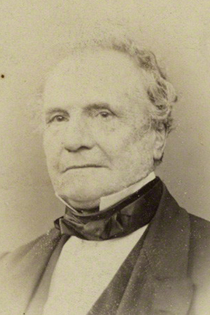
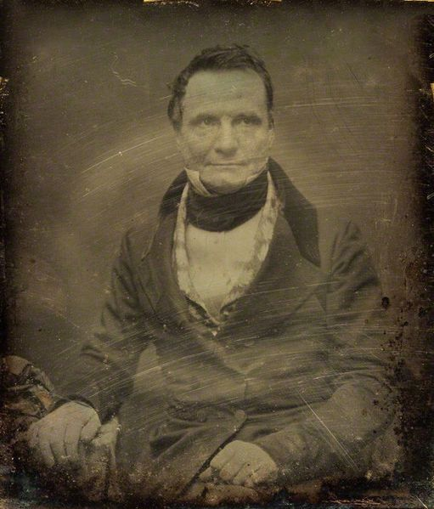
Notes:
9 – 6 every day
Excellent food
Free conference ticket in exchange for a lightning talk is a great deal

Slide 4
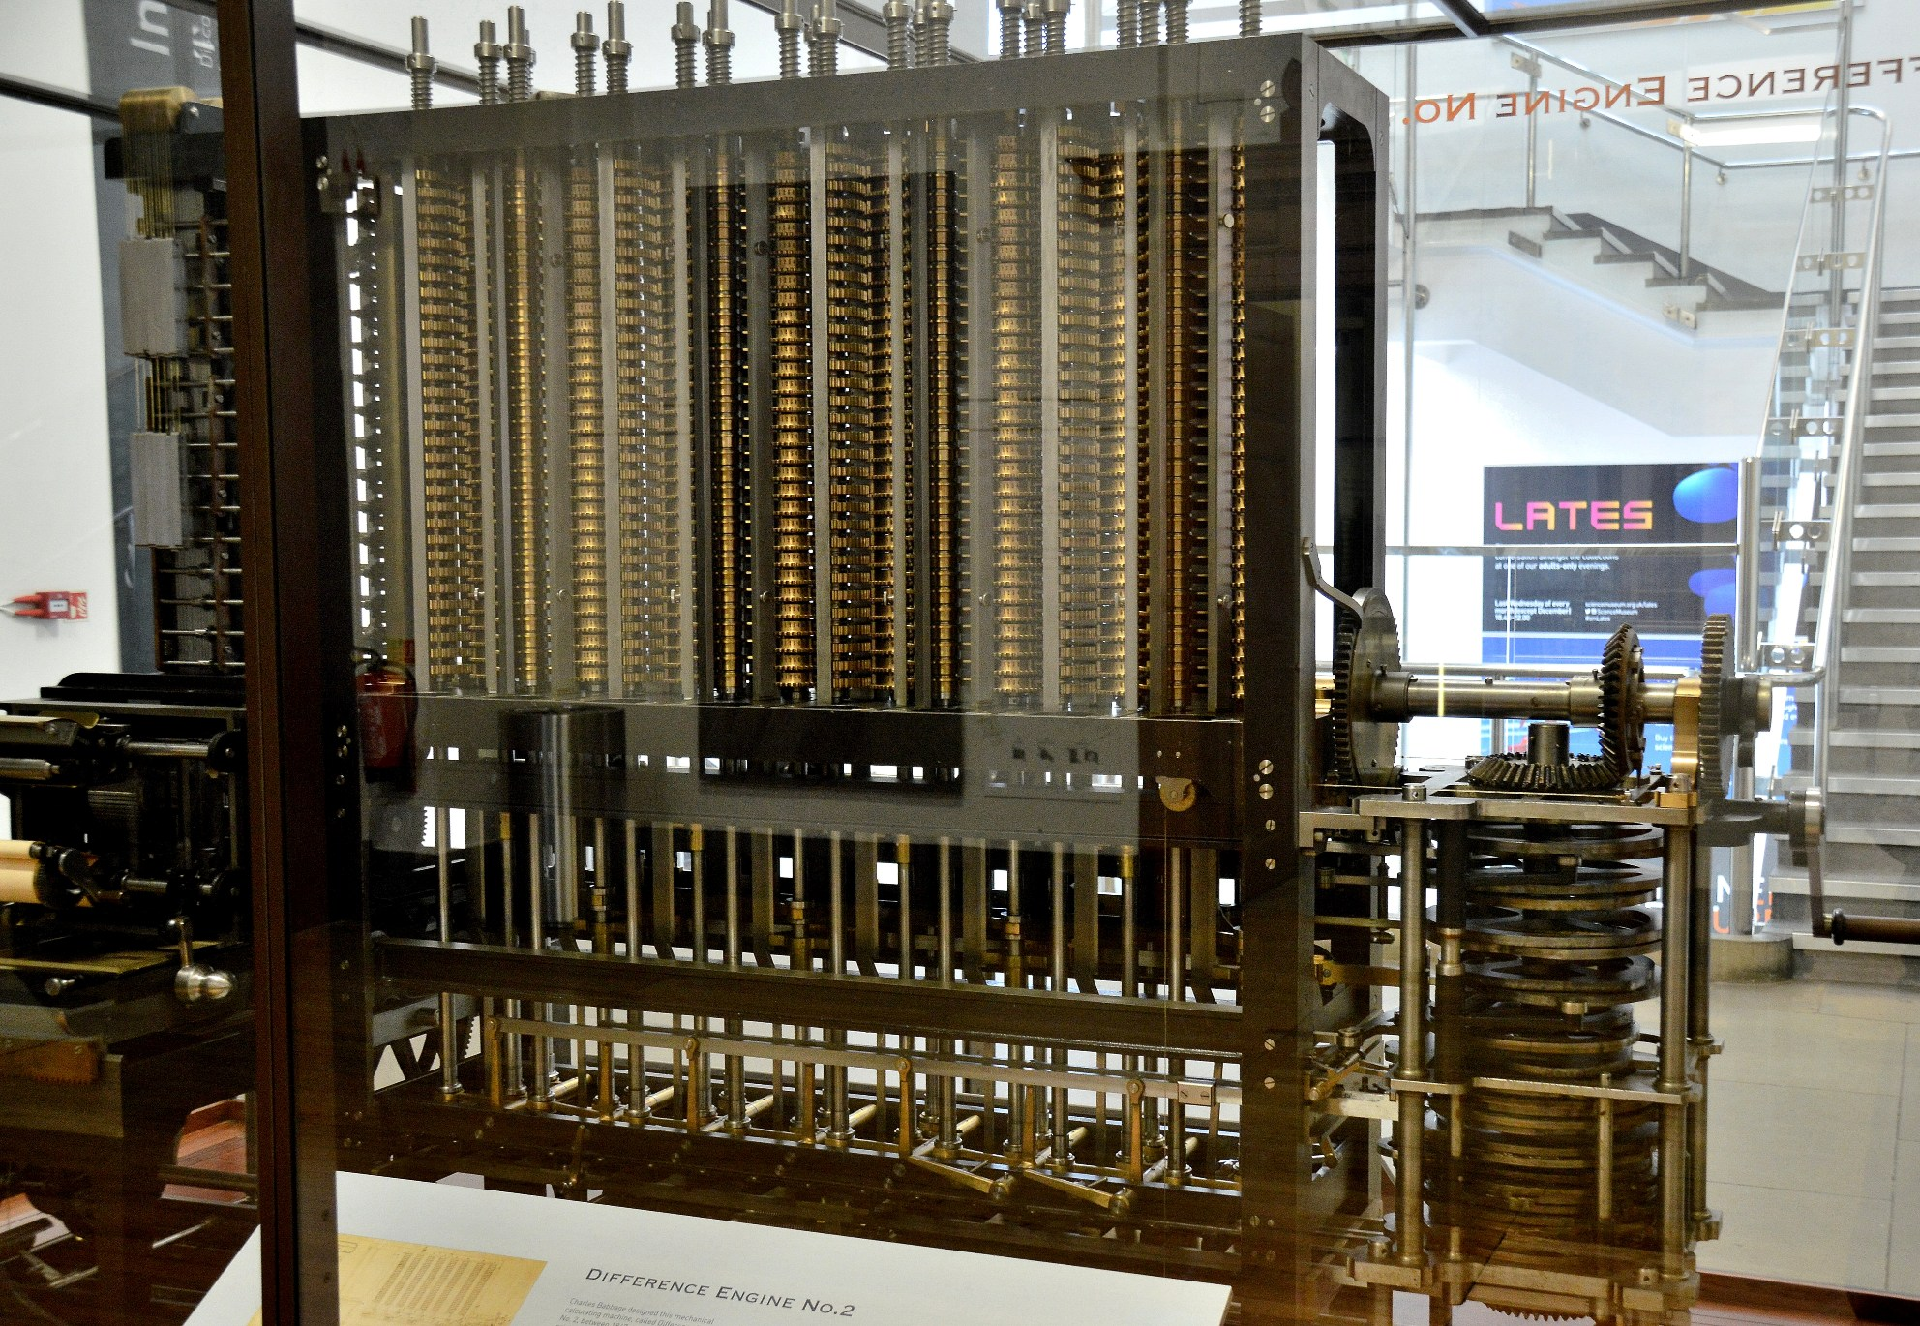
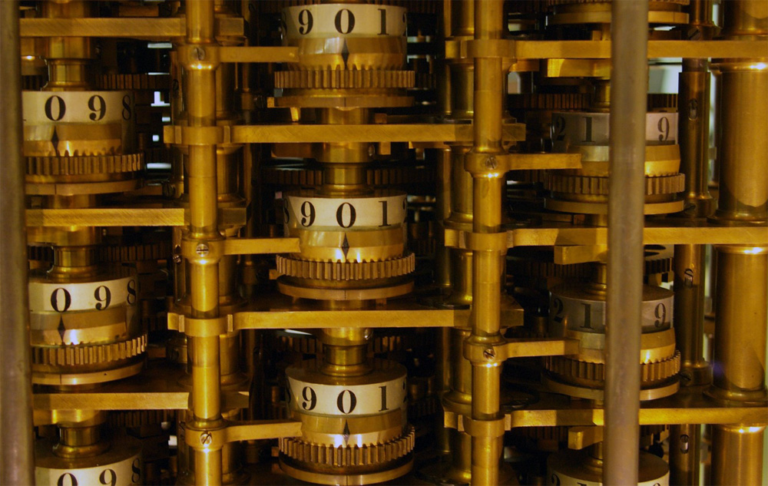
Notes:
Difference Engine No.1 – proof of concept -1819-22
Govt. grant of £1,700 to develop D.E. No. 2 in 1823 (20 digits, 6th order differences)
Designed to calculate & print mathematical tables to eradicate human error
1832 - small working model of part of the mechanism – 6 digits, 2nd order differences
Govt abandoned in1842 after spending £17,000
1846-49 – design for engine No. 2 (31 digits, 7th order differences) fewer parts and faster operation thanks to Analytical Engine

Slide 5
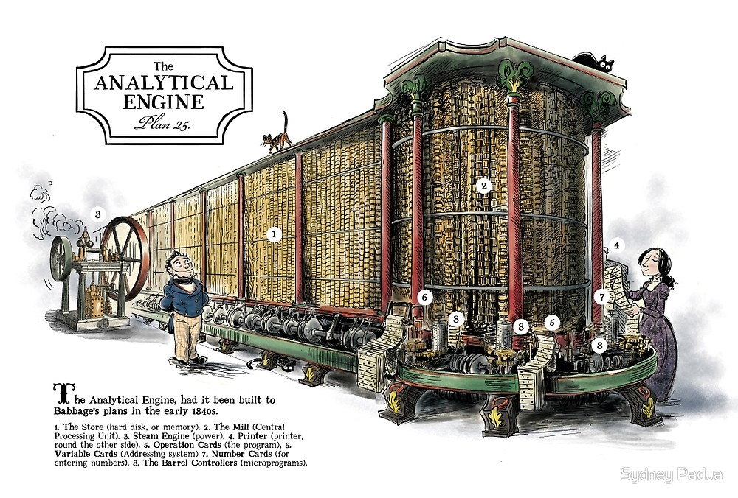
Notes:
Started design in 1833
Punched cards for input
Store – 1,000 x 40 (or 50?) digit numbers
Mill – ALU – Add, Subtract, Multiply, Divide, comparison, optional square root
‘Microcode’ architecture

Slide 6
Architecture
40- (50-?) digit decimal “word”
1000 word Store
Control flow by punched cards
10s complement for negative values
Notes:
Why decimal?

Slide 7
The Mill
Mill performs basic maths operations (+, -, *, /)
2 ingress axes, 1 egress axis
Load operations load ingress axes alternately
2nd load automatically triggers mill operation
Run up lever set if an operation causes an overflow
Notes:
This is simplified from Babbage’s designs – I have ignore the primed axes on ingress and egress for example.

Slide 8
Instruction Set
Number Cards
Naaa [+-]nnn… :Store value nnn... at aaa
Operation Cards
+, -, *, /
Variable Cards
Laaa : Load value at aaa into ingress axes
Zaaa : Load value at aaa and set value to zero
Saaa : Save egress axis to address aaa
Notes:
John Walker – founder of AutoDesk – has gathered together a lot of Analytical Engine-related material at fourmilab.ch
He devised the instruction set I’m using

Slide 9
Instruction Set 2
Combinatorial Cards
C[FB][+?]nn
F: forward, B: back, +: always, ?:if run up lever is set
nn: number of instructions to skip
Action Cards
B: Ring bell
H: Halt
P: Print the value on the axis
No character in column1: Comment
Notes:
John Walker – founder of AutoDesk – has gathered together a lot of Analytical Engine-related material at fourmilab.ch
He devised the instruction set I’m using
What program should we write to test this out? It’s an FP conference so…

Slide 10
Fibonacci Sequence
N004 30 . No of terms
N000 0 . Constant zero
N005 1 . Constant 1
N001 0 . Previous term
N002 1 . Current term
N003 . Next term
+
L002
P
L001 . curr + prev
S003 . -> next
L002
L000
S001 . curr -> prev
L003
L000
S002 . next -> curr
-
L004
L005
S004 . dec iteration
CF?1 . stop on run up
CB+17 . repeat
H
Notes:
This is a functional programming conference…
2 columns to make it legible

Slide 11
Type Definitions
type Wheel =
| Pos0 | Pos1 | Pos2 | Pos3
| Pos4 | Pos5 | Pos6 | Pos7
| Pos8 | Pos9
type Stack = {
wheels: Wheel list
negative : bool }
Notes:
To make this interesting, were not going to use built-in integer maths

Slide 12
Wheel
module Wheel
open Types
let values = [Pos0;Pos1;Pos2;Pos3;Pos4;Pos5;Pos6;Pos7;Pos8;Pos9]
let private indexOf wheel =
values |> List.findIndex (fun v -> v = wheel)
let private valueAt index =
values.[index % values.Length]
let inc wheel = valueAt (indexOf wheel + 1)
let dec wheel = valueAt (indexOf wheel - 1)

Slide 13
(Half) Addition
let add wheel1 wheel2 =
let mutable carry = false
let mutable result = wheel1
let mutable addor = wheel2
while addor <> Pos0 do
addor <- dec addor
result <- inc result
carry <- carry || result = Pos0
(result, carry)
Notes:
A binary half-adder takes 2 binary value and provides a result and a carry value – this is similar for decimal
In the Analytical Engine, only stacks in the mill would have had the ability to carry from one wheel to the next.

Slide 14
Negative Values
let complements = values |> List.rev
let withComplements = List.zip values complements
let complement wheel =
withComplements
|> List.find (fun w -> fst w = wheel) |> snd

Slide 15
Negate The Stack
let carryUp (carry : bool) (wheel: Wheel) =
((if carry then wheel |> Wheel.inc else wheel),
(wheel = Pos9 && carry))
let add1 wheels =
wheels |> List.mapFold carryUp true |> fst
let complement wheels =
wheels |> List.map Wheel.complement |> add1
let negate stack =
{ wheels = stack.wheels |> complement
negative = not stack.negative }

Slide 16
Full Adder
let add (ingress : Stack list) =
let carryUp carryIn (wheel, carryThrough) =
let wheel' = if carryIn then Wheel.inc wheel else wheel
let carryOut = (wheel = Pos9 && carryIn) || carryThrough
(wheel', carryOut)
let wheels, carry =
List.zip ingress.[0].wheels ingress.[1].wheels
|> List.map (fun (w1, w2) -> Wheel.add w1 w2)
|> List.mapFold carryUp false
let negative =
ingress.[0].negative <> ingress.[1].negative <> carry
let runUp = ingress.[0].negative <> negative
({ wheels = wheels; negative = negative }, runUp )

Slide 17

Go out & FIGHT CRIME!

Slide 18
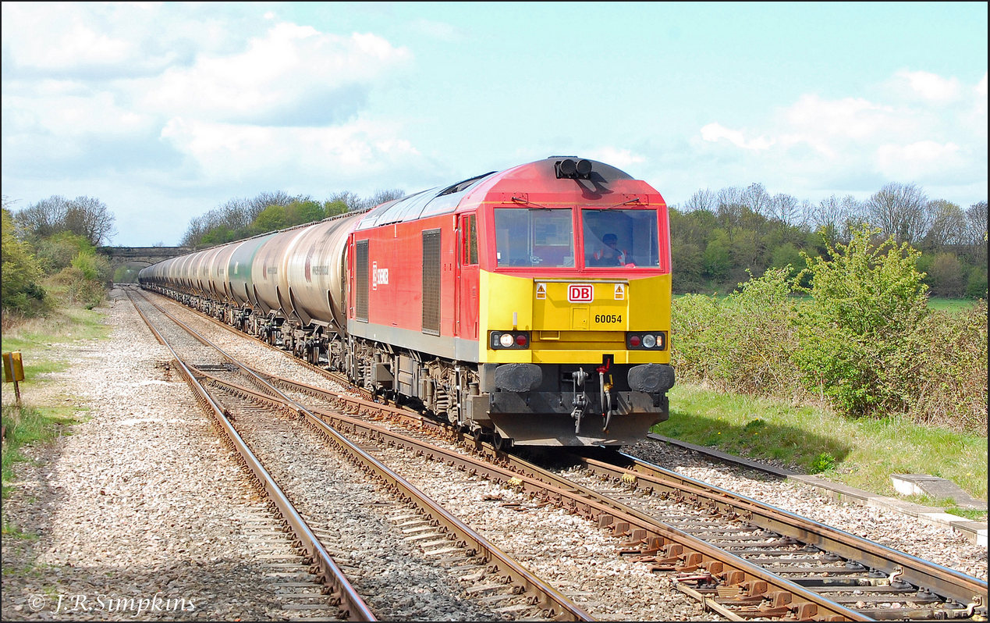
Credits & References
Many thanks to Sydney Padua for the use of her amazing illustrations
2DGoggles: http://sydneypadua.com/2dgoggles/
The Thrilling Adventures of Lovelace & Babbage (Particular Books, 2015)
Fourmilab: http://www.fourmilab.ch/babbage/
Code: https://github.com/JohnStov/AnalyticalEngine
Notes:
There is a class 60 locomotive named ‘Charles Babbage’
Babbage briefly worked for the Liverpool & Manchester Railway Company, and invented the locomotive ‘pilot’ designed to prevent stray items on the track from interfering with the locomotive.

